Slide 1

Prof Arjuna De Silva
Department of Medicine

Slide 2
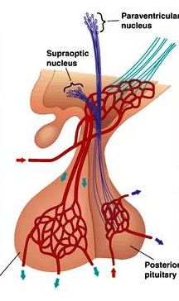
Pituitary stalk
Portal veins
Anterior pituitary

Slide 3
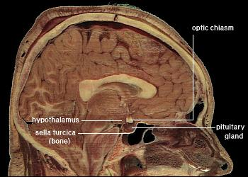
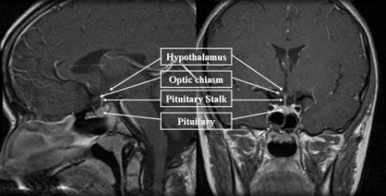
Anatomical Relationships of the Pituitary

Slide 4
Anterior Pituitary
Produces 6 hormones -
LH/FSH
GH
Prolactin
TSH
ACTH

Slide 5
Control of Hormone Secretion
Hypothalamic control –
GnRH Dopamine
GHRH Somatostatin
TRH
CRH
Negative/Positive feedback from target organs

Slide 6
Posterior Pituitary
Neural fibres originating from Supra-optic & Para-ventricular nuclei of hypothalamus
2 hormones - Oxytocin
Vasopressin

Slide 7
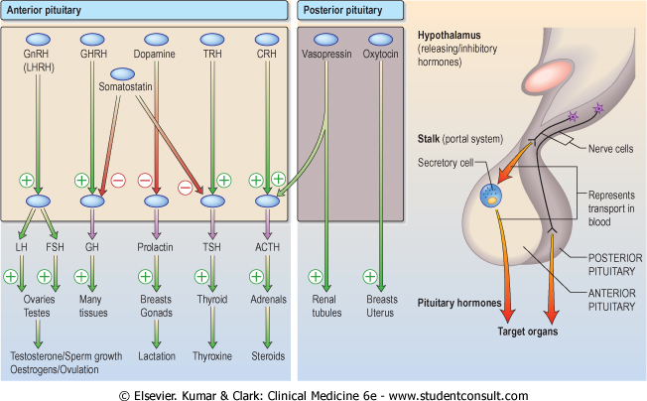
Hypothalamic Releasing Hormones & Pituitary Trophic Hormones

Slide 8
Pituitary Tumours
Commonest cause of pituitary disease
Majority – benign pituitary adenoma
Macroadenoma >10 mm
Microadenoma <10 mm

Slide 9
Pituitary Tumours
Prolactinoma – most micro
Cushing’s disease – most small
Acromegaly – mm to cm
Nelson’s Syndrome – most large
Non-functioning tumours - large
Craniopharyngioma – v. large

Slide 10
Pituitary Tumours
Large tumours cause pituitary hypofunction by compressing normal tissue
If tumours damage pituitary stalk →hyperprolactinaemia

Slide 11
Pituitary Tumours
Symptoms due to –
  1) Local effects of a tumour
  2) Excess hormone secretion
  3) Inadequate production of hormones → hypopituitarism

Slide 12
Local Effects
Visual pathways – field defects
visual loss
Cavernous sinus – III, IV & VI cranial nerve palsies
Bones & meninges – headache

Slide 13
Local Effects ct
Hypothalamus – altered appetite
obesity
thirst
precocious puberty somnolence / wakefulness
Ventricles – hydrocephalus
Sphenoid sinus – CSF rhinorrhoea

Slide 14
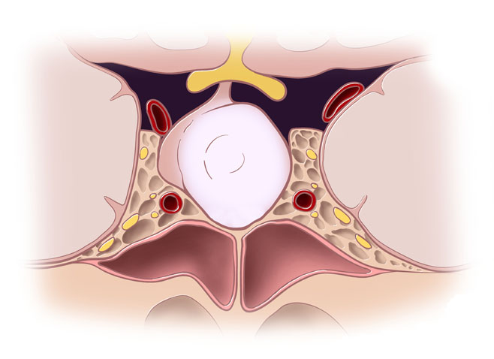
Structures Compressed by Pituitary Tumours

Slide 15
Investigating Local Effects
Lateral skull X-ray → enlarged pituitary fossa
Visual fields by perimetry →
upper temporal quadrantanopia
bitemporal hemianopia
MRI pituitary

Slide 16
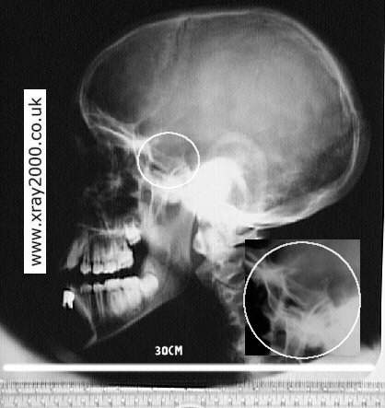
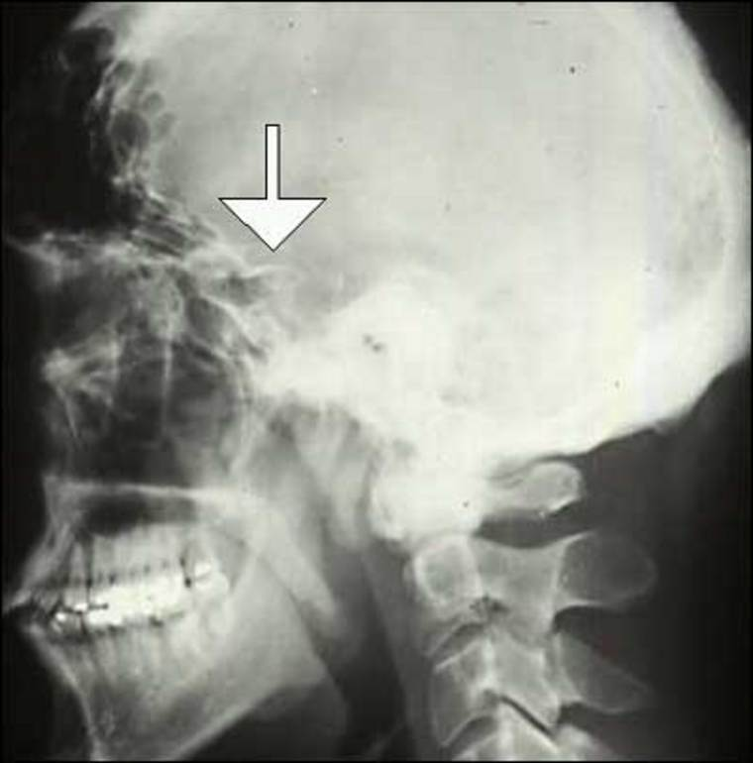
Lateral Skull X-ray – enlarged pituitary fossa

Slide 17
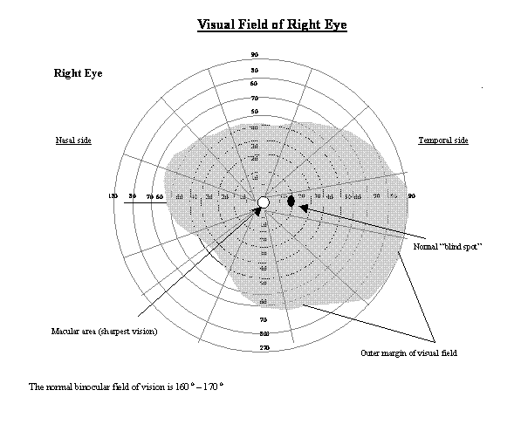
Perimetry – Normal Visual Field

Slide 18
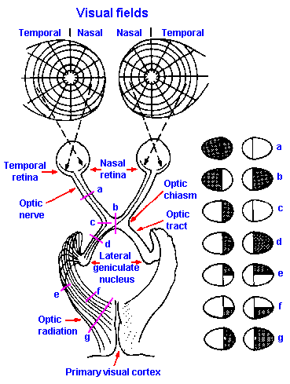

Visual Fields in Pituitary Tumours

Slide 19
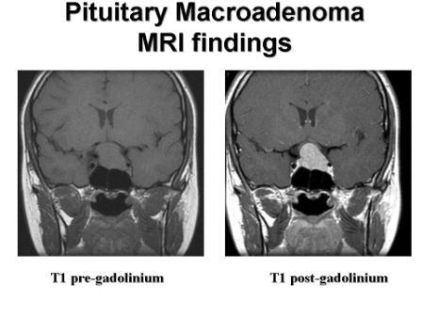
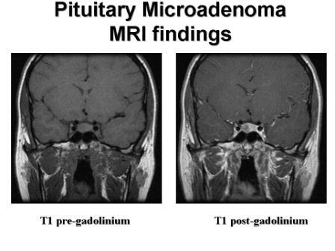
MRI Pituitary

Slide 20
2) Effects due to Excess Hormone Secretion
Macro & micro-adenomas may be functional or non-functional
3 main hyper-secretion syndromes

Slide 21
2) Effects due to Excess Hormone Secretion
Prolactin excess – (chromophobe adenoma)
prolactinoma / hyperprolactinaemia → subfertility/ impotence, galactorrhoea
GH excess (acidophil adenomas) →
acromegaly / gigantism
ACTH excess (basophil adenomas) →
Cushings disease
Nelson’s syndrome

Slide 22
3) Effects due to Hormone Deficiency
GH – short stature in children
TSH and/or ACTH – slow lethargic pale adult

Slide 23
Investigating Pituitary Function
If high level of hormone is expected → suppression test
If low level of hormone is expected → stimulation test

Slide 24
Investigating Pituitary Function
Levels of pituitary & target organ hormones can be measured
This has largely replaced anterior pituitary dynamic testing using hypothalamic releasing hormones

Slide 25
Investigating Pituitary Function
GH – Insulin Tolerance Test (deficiency)
Glucose Tolerance Test (excess)
ACTH – basal (8 am) cortisol
Synacthen test (deficiency)
Insulin Tolerance Test (deficiency)
Prolactin – basal level

Slide 26
Investigating Pituitary Function
LH/FSH – basal levels
Estradiol
Testosterone
TSH – basal level
fT4

Slide 27
Treatment of Pituitary Tumours - Aims
Remove or control tumour
Reduce excess hormone secretion
Replace hormone deficiencies

Slide 28
Remove or Control Tumour
Surgery – commonly trans-sphenoidal
trans-frontal if large
Radiotherapy –
when surgery impractical or incomplete
will control but not abolish tumour mass
Medical Therapy –
Somatostatin analogues - Octreotide, Lanreotide Dopamine agonists – Bromocriptine, Cabergoline
GH receptor antagonists - Pegvisomant

Slide 29
Reduce excess hormone secretion
Usually by surgical removal of tumour
Dopamine agonists → for prolactinoma
Somatostatin analogues → for acromegaly

Slide 30
Replace hormone deficiencies
Adrenal – Hydrocortisone
Thyroid – Thyroxine
Growth – recombinant human GH

Slide 31
Replace hormone deficiencies ct
Gonadal –
male → testosterone
female → cyclical oestrogen & progesterone
Thirst – Desmopressin
Breasts – Dopamine agonists

Slide 32

Prof Arjuna De Silva
Department of Medicine

Slide 33


Slide 34
Deficiency of hypothalamic releasing hormones or pituitary trophic hormones
Single or multiple
Single deficiency rare (LH/FSH, ACTH)
Multiple deficiencies commonly due to pituitary & hypothalamic tumours, surgery or radiotherapy

Slide 35
Progressive loss of pituitary function
LH/FSH → GH → TSH → ACTH
Hyper-prolactinaemia (not deficiency) due to loss of Dopamine inhibition
Pan-hypopituitarism → deficiency of all anterior pituitary hormones
Vasopressin & Oxytocin deficiency only if hypothalamus is affected

Slide 36
Causes
Congenital – Kallman’s
Infective – TB Meningitis
Vascular – Sheehan’s
Immunological – Abs
Neoplastic – tumours, meningioma, craniopharyngioma, 2ry deposits, lymphoma
Trauma – fracture, surgery
Infiltration – sarcoidosis
Others – radio and chemo-therapy

Slide 37
Clinical Features
Same as primary deficiency of peripheral endocrine gland
eg - TSH deficiency features same as in primary hypothyroidism
Tiredness, malaise - ↓ TSH/ACTH
Slow thinking & movement, dry skin & hair, cold intolerance, weight gain - ↓ TSH
Hypotension, hyponatraemia, CV collapse with inter-current illness - ↓ ACTH

Slide 38
Clinical Features
Loss of libido & secondary sexual hair, amenorrhoea, impotence - ↓ LH/FSH
Galactorrhoea, hypogonadism - ↑ Prolactin
GH deficiency may be clinically silent in adults (children → short stature)
Weight loss – pituitary cachexia
Pallor with hairlessness – longstanding panhypopituitarism

Slide 39
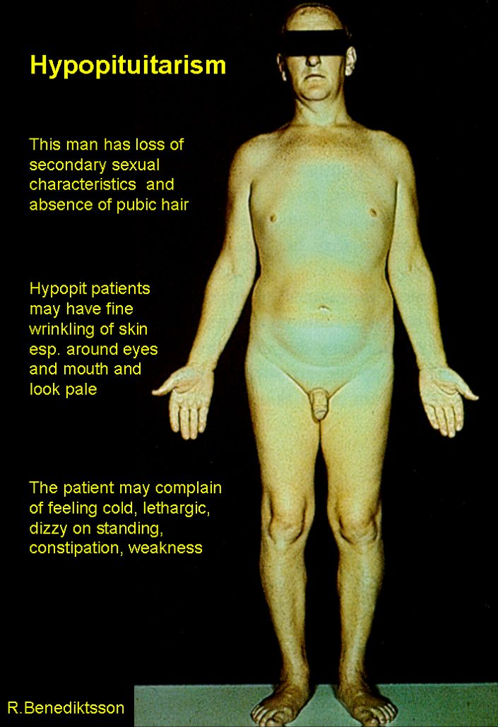

Slide 40
Investigations
If gonadal function is normal multiple pituitary deficiencies is unlikely
Basal levels
eg: fT4, 9 am cortisol
Stimulatory tests
eg: Insulin tolerance test
Synacthen test

Slide 41
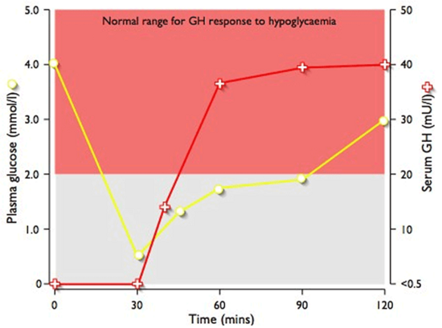
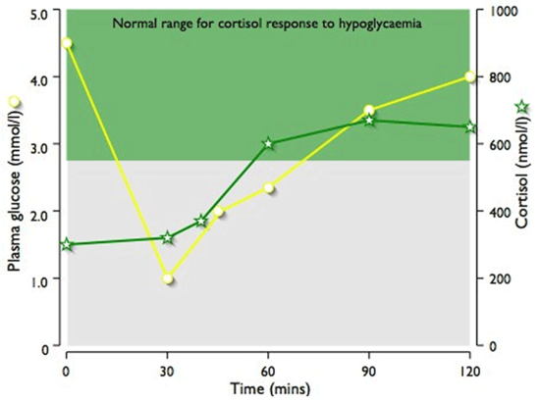
Insulin Tolerance Test – Normal Response
Cortisol
GH

Slide 42
Treatment - by Replacement
Oral replacement with hydrocortisone & thyroxine
Testosterone & oestrogen + progestogen
For fertility → HCG (acts like LH) + FSH
pulsatile GnRH
Recombinant human GH

Slide 43
Remember ..
Replace steroid BEFORE thyroxine
Can precipitate adrenal crisis
Steroid deficiency may mask diabetes insipidus (impaired urinary concentration)

Slide 44


Slide 45
GH stimulates skeletal & soft tissue growth
GH excess → gigantism in children acromegaly in adults
Acromegaly almost always due to pituitary tumour
(GHRH excess v.rare)
Incidence 3-4 / million / year
Prevalence 50-80 / million worldwide

Slide 46
Symptoms
1/3 – change in appearance
1/4 – headache or visual field defects
Increased size of hands & feet
↑ sweating
Tiredness, weight gain
Amenorrhoea / oligomenorrhoea, Galactorrhoea
Impotence / poor libido
Deep voice, goitre, sleep apnoea
Muscle weakness, joint pains

Slide 47
Signs
Prognathism
Inter-dental separation
Large tongue, spade like hand & feet
Hirsutism, thick greasy skin
Carpal tunnel syndrome
Visual field defects
Hypertension, oedema, heart failure
Arthropathy, proximal myopathy
Glycosuria

Slide 48
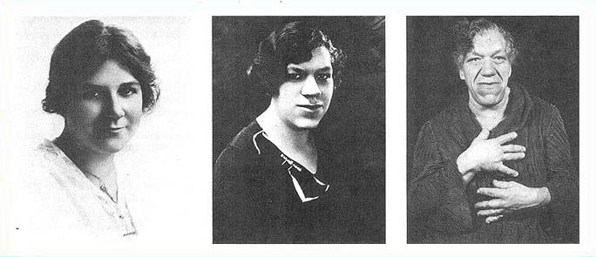
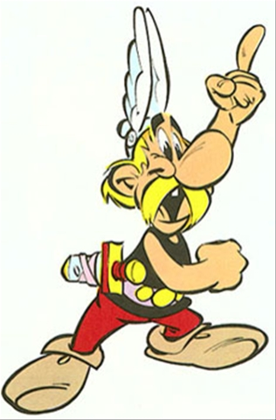
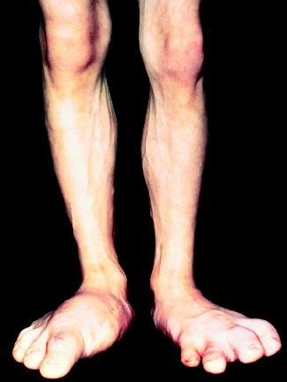
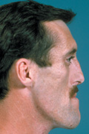
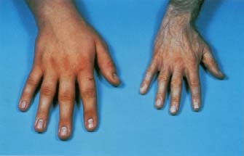

Slide 49
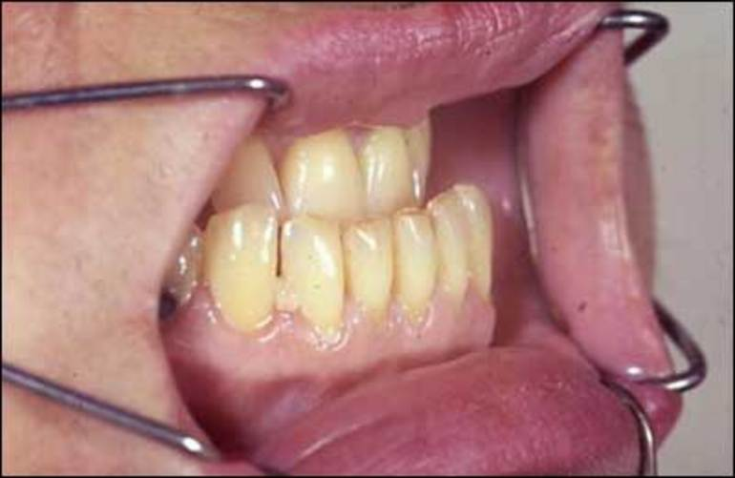
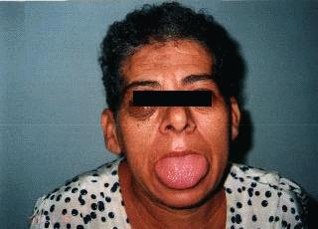
Inter-dental
Separation
Large tongue

Slide 50
Symptoms & signs of hypopituitarism may also be present – compression of normal pituitary
eg – hypothyroidism, hypogonadism

Slide 51
Investigations
GH levels –
pulsatile
excludes acromegaly if undetectable
non-diagnostic if detectable
Glucose Tolerance Test –
diagnostic – glucose load fails to suppress GH
IGF-1 levels –
always raised
reflects mean 24 hour GH levels

Slide 52
Investigations
Visual fields by perimetry
MRI pituitary
Pituitary function tests
Prolactin –
elevated when some tumours secrete both
GH & Prolactin

Slide 53
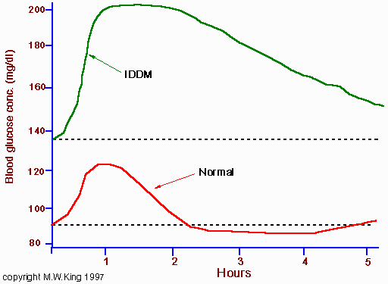
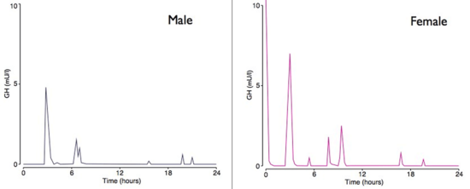
Normal Pulsatile GH Secretion
Glucose Tolerance Test

Slide 54
Management - General
Untreated → mortality high
from heart failure, CAD, hypertension,
large bowel tumours
Monitor response to therapy with
GH & IGF-1 levels
Treat - hypopituitarism
DM & HPT

Slide 55
Management - Specific
Surgery –
first line
trans-sphenoidal
most with microadenoma remit
Pituitary Radiotherapy –
if surgery fails
combined with drugs

Slide 56
Management - Specific
Somatostatin analogues –
Octrotide, Lanreotide
as primary therapy OR
short term till surgery or RT becomes effective
Dopamine agonists –
Bromocriptine, Cabergoline
to shrink tumours before surgery or to control symptoms post-op
GH receptor antagonists –
Pegvisomant
add-on

Slide 57


Slide 58
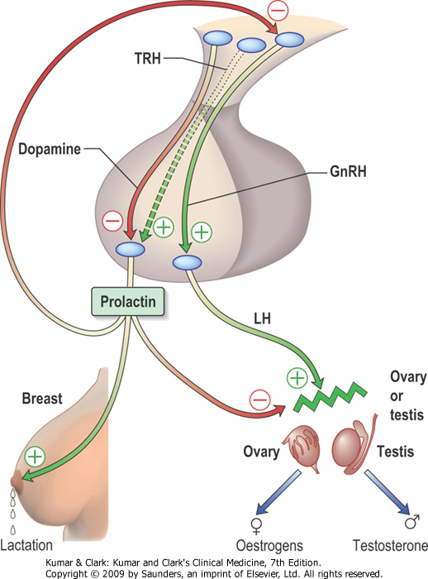

Slide 59
Causes
Physiological – pregnancy & lactation
stress, sleep, coitus
Pathological – prolactinoma
acromegaly
pituitary stalk compression
PCOS
hypothyroidism
Iatrogenic –
dopamine antagonists – metoclopromide, domperidone, phenothizine
opiates

Slide 60
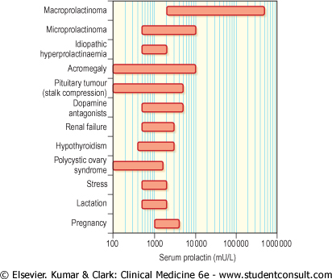
Range of s.Prolactin in Hyperprolactinaemia

Slide 61
Clinical Features
High prolactin → stimulates breasts to produce milk
inhibits GnRH, FSH & LH
Galactorrhoea
Oligo/amenorrhoea
↓ libido
Subfertility / ↓ potency
Features of oestrogen/androgen deficiency
(long term → osteoporosis)
Delayed or arrested puberty
Headache &/or visual field defects

Slide 62
Investigations
Repeat prolactin level - to exclude physiological or drug-induced hyper-prolactinaemia
Visual fields
fT4 & TSH
Anterior pituitary function
MRI pituitary

Slide 63
If pituitary mass on MRI..
Is it prolactinoma or stalk compression by non-functioning pituitary tumour?
Prolactin > 5000 mu/l + macroadenoma = prolactinoma
Prolactin > 2000 mu/l + microadenoma = prolactinoma

Slide 64
Treatment
Control Prolactin level + shrink tumour with Dopamine agonists –
Bromocriptine, Cabergoline, Quinagolide
Hyperprolactinaemia may recur on stopping therapy
Trans-sphenoidal surgery & radiotherapy rarely used

